Slide 1
BouldeR Kickoff Meeting!
library(dplyr)
rladies_global %>%
filter(city == ‘Boulder')
Notes:
Welcome!
My name
Goals: orientation on R Ladies, introductions to use, introductions to you, brainstorm meeting format ideas
1st: story of R Ladies & code of conduct
2nd: who are we?
3rd: fun/useful R packages authored (at least in part) by women

Slide 2
R-Ladies Global
Notes:
what is R ladies?
How does this chapter fit into the broader organization?

Slide 3
What is R Ladies?
Worldwide organization whose mission is to promote gender diversity in the R community and encourage, inspire, and empower people of genders currently underrepresented in the R community.
Notes:
* R ladies Global: worldwide organization - mission of promoting gender diversity in the R community.
* Specific goal: provide a community that encourages, inspires, and empowers R enthusiasts of currently underrepresented genders in the R community

Slide 4
What is R Ladies?
Worldwide organization whose mission is to promote gender diversity in the R community and encourage, inspire, and empower people of genders currently underrepresented in the R community.
R-Ladies’ primary focus: Build a collaborative global network to facilitate minority gender R enthusiasts
Notes:
* Main focus of R ladies is to build collaborative networks of R enthusiasts of minority genders to facilitate skill sharing and learning in supportive spaces

Slide 5
What is the history of R Ladies?
Notes:
Huge fan of origins stories
Tell you a bit about the origins of R ladies as a global organization

Slide 6
What is the history of R Ladies?
2012: Founded by Gabriela de Quieroz in San Francisco
Notes:
* 2012: R Ladies founded by then-graduate student Gabriela de Quieroz
* Moved to San Fransisco from Brazil for her graduate studies
* Found herself intimidated to speak up in meetups because male dominated
* So, she decided to start an R meetup focused on women
* Next 4 years: R ladies grew into many more meetups: R ladies Twin Cities, R Ladies Taipei, and R-Ladies London.

Slide 7
What is the history of R Ladies?
2012: Founded by Gabriela de Quieroz in San Francisco
Sept. 2016: Acquired R-Consortium global expansion grant
Notes:
* 2016: chapters wanted higher-level organization
* Applied for and were awarded an R-Consortium grant to expand the R Ladies network and provide things like meetup pages to the chapters for free.

Slide 8
What is the history of R Ladies?
2012: Founded by Gabriela de Quieroz in San Francisco
Sept. 2016: Acquired R-Consortium global expansion grant
July 2019: Registered non-profit in California
Notes:
This summer: became a registered non-profit
Hopes for future donation structure

Slide 9
What is the history of R Ladies?
2012: Founded by Gabriela de Quieroz in San Francisco
Sept. 2016: Acquired R-Consortium global expansion grant
July 2019: Registered non-profit in California
Currently: 175 chapters in 48 countries with >53000 members
Notes:
Today: global network is over 175 local chapters, 47 countries, over 53000 members on meetup

Slide 10
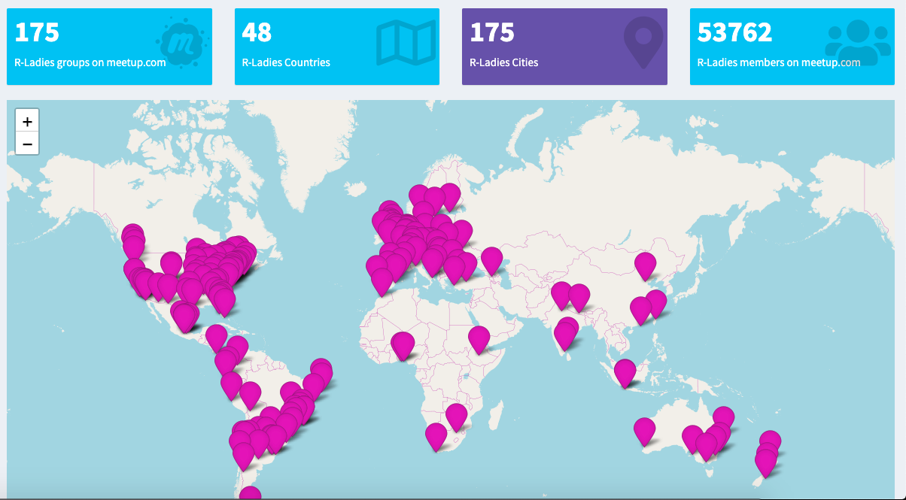
R Ladies Shiny Map: gqueiroz.shinyapps.io/rshinylady/
Notes:
Global distribution of active chapters
You can play around with this app online – it’ll tell you how many members different chapters have and other fun things

Slide 11
Code of Conduct
Notes:
R ladies global has a very nicely laid out and specific code of conduct to keep all attendees safe

Slide 12
Code of Conduct
R-Ladies meetups and online communications should be a welcoming, supportive, harassment-free space for all people
Notes:
Overall goal: to make sure this space and any meetup communications are welcoming, supportive, and harassment-free

Slide 13
Code of Conduct
R-Ladies meetups and online communications should be a welcoming, supportive, harassment-free space for all people
If you feel uncomfortable, are experiencing harassment, notice that someone else is being harassed, or have any other concerns, please contact the local organizing team and/or the Global Leadership Team via
Local team: boulder@rladies.org
Global team: reporting@rladies.org
Notes:
If you feel uncomfortable or are experiencing harassment, please do not hesitate to contact us or the global team as you see fit

Slide 14
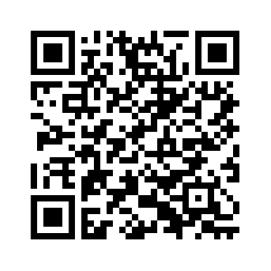
Code of Conduct
rladies.org/code-of-conduct/
Notes:
And I’ll simply encourage all of you to go look at the code of conduct which can be found on the r ladies website!

Slide 15
R-Ladies BouldeR

Slide 16
R Ladies BouldeR
Organizing team: Lisa Moller, Leigh Alexander, Marta Jankowska, and Courtney Van Den Elzen
Timing: 2nd Tuesday of each month, 6-7PM
Location: here! (2990 Wilderness Place)
Sponsored by: SomaLogic

Slide 17
R Ladies BouldeR
Potential meeting types
short tutorial + code along
informal project help presentations (you present, we help!)
open coding hours + R help,
Networking mixers
(your idea here?)
Notes:
One thing we want all of your help with is deciding what type of meetings we should do
So, as I finish this up, think about what you might want out of this group moving forward
These are some potential meeting types that we came up with, but we’re open to suggestions during our discussion in a few minutes.

Slide 18
Meet Your R-Ladies BouldeR Organizers!

Slide 19
Courtney Van Den Elzen
PhD Student, Evolutionary Biology, CU Boulder
Background: Mathematics and Evolutionary Biology
UseR since: 2012
R expertise: lme4 (GLMMs), ggplot2 (data visualization)

Slide 20
R Package Highlight: {BRRR}
Author: Brooke Watson
Similar to ‘beepr’ package but rap sounds!
http://www.therapboard.com/
See R Ladies Boulder Github for BRRR package sampler script

Slide 21
Lisa Moller
Data Analyst, Boulder County Assessor’s Office
Background: Math, Biology, Health Law and Policy (and Centurylink)
User since: 2015
Expertise: outside of R… I’m here to learn! (SQL, Python, Tableau, PowerBI)

Slide 22
R Package Highlight: ropenaq
Author: Maëlle Salmon
Accesses air quality data on https://openaq.org/
A little background from Maëlle herself… https://www.r-bloggers.com/ropenaq-a-breath-of-fresh-airr/

Slide 23
Leigh Alexander
Bioinformatics Scientist @ SomaLogic
Ph.D. in Cognitive Psychology & Neuroscience
UseR since 2006 (but much more since 2016)
R expertise
Machine Learning (caret, tidymodels)
Reproducibility (RMarkdown)
Visualization (ggplot2, plotly)
And generally obsessed with the tidyverse!

Slide 24
R Package Highlight: {here}
Jenny Bryan
Kirill Muller

Slide 25
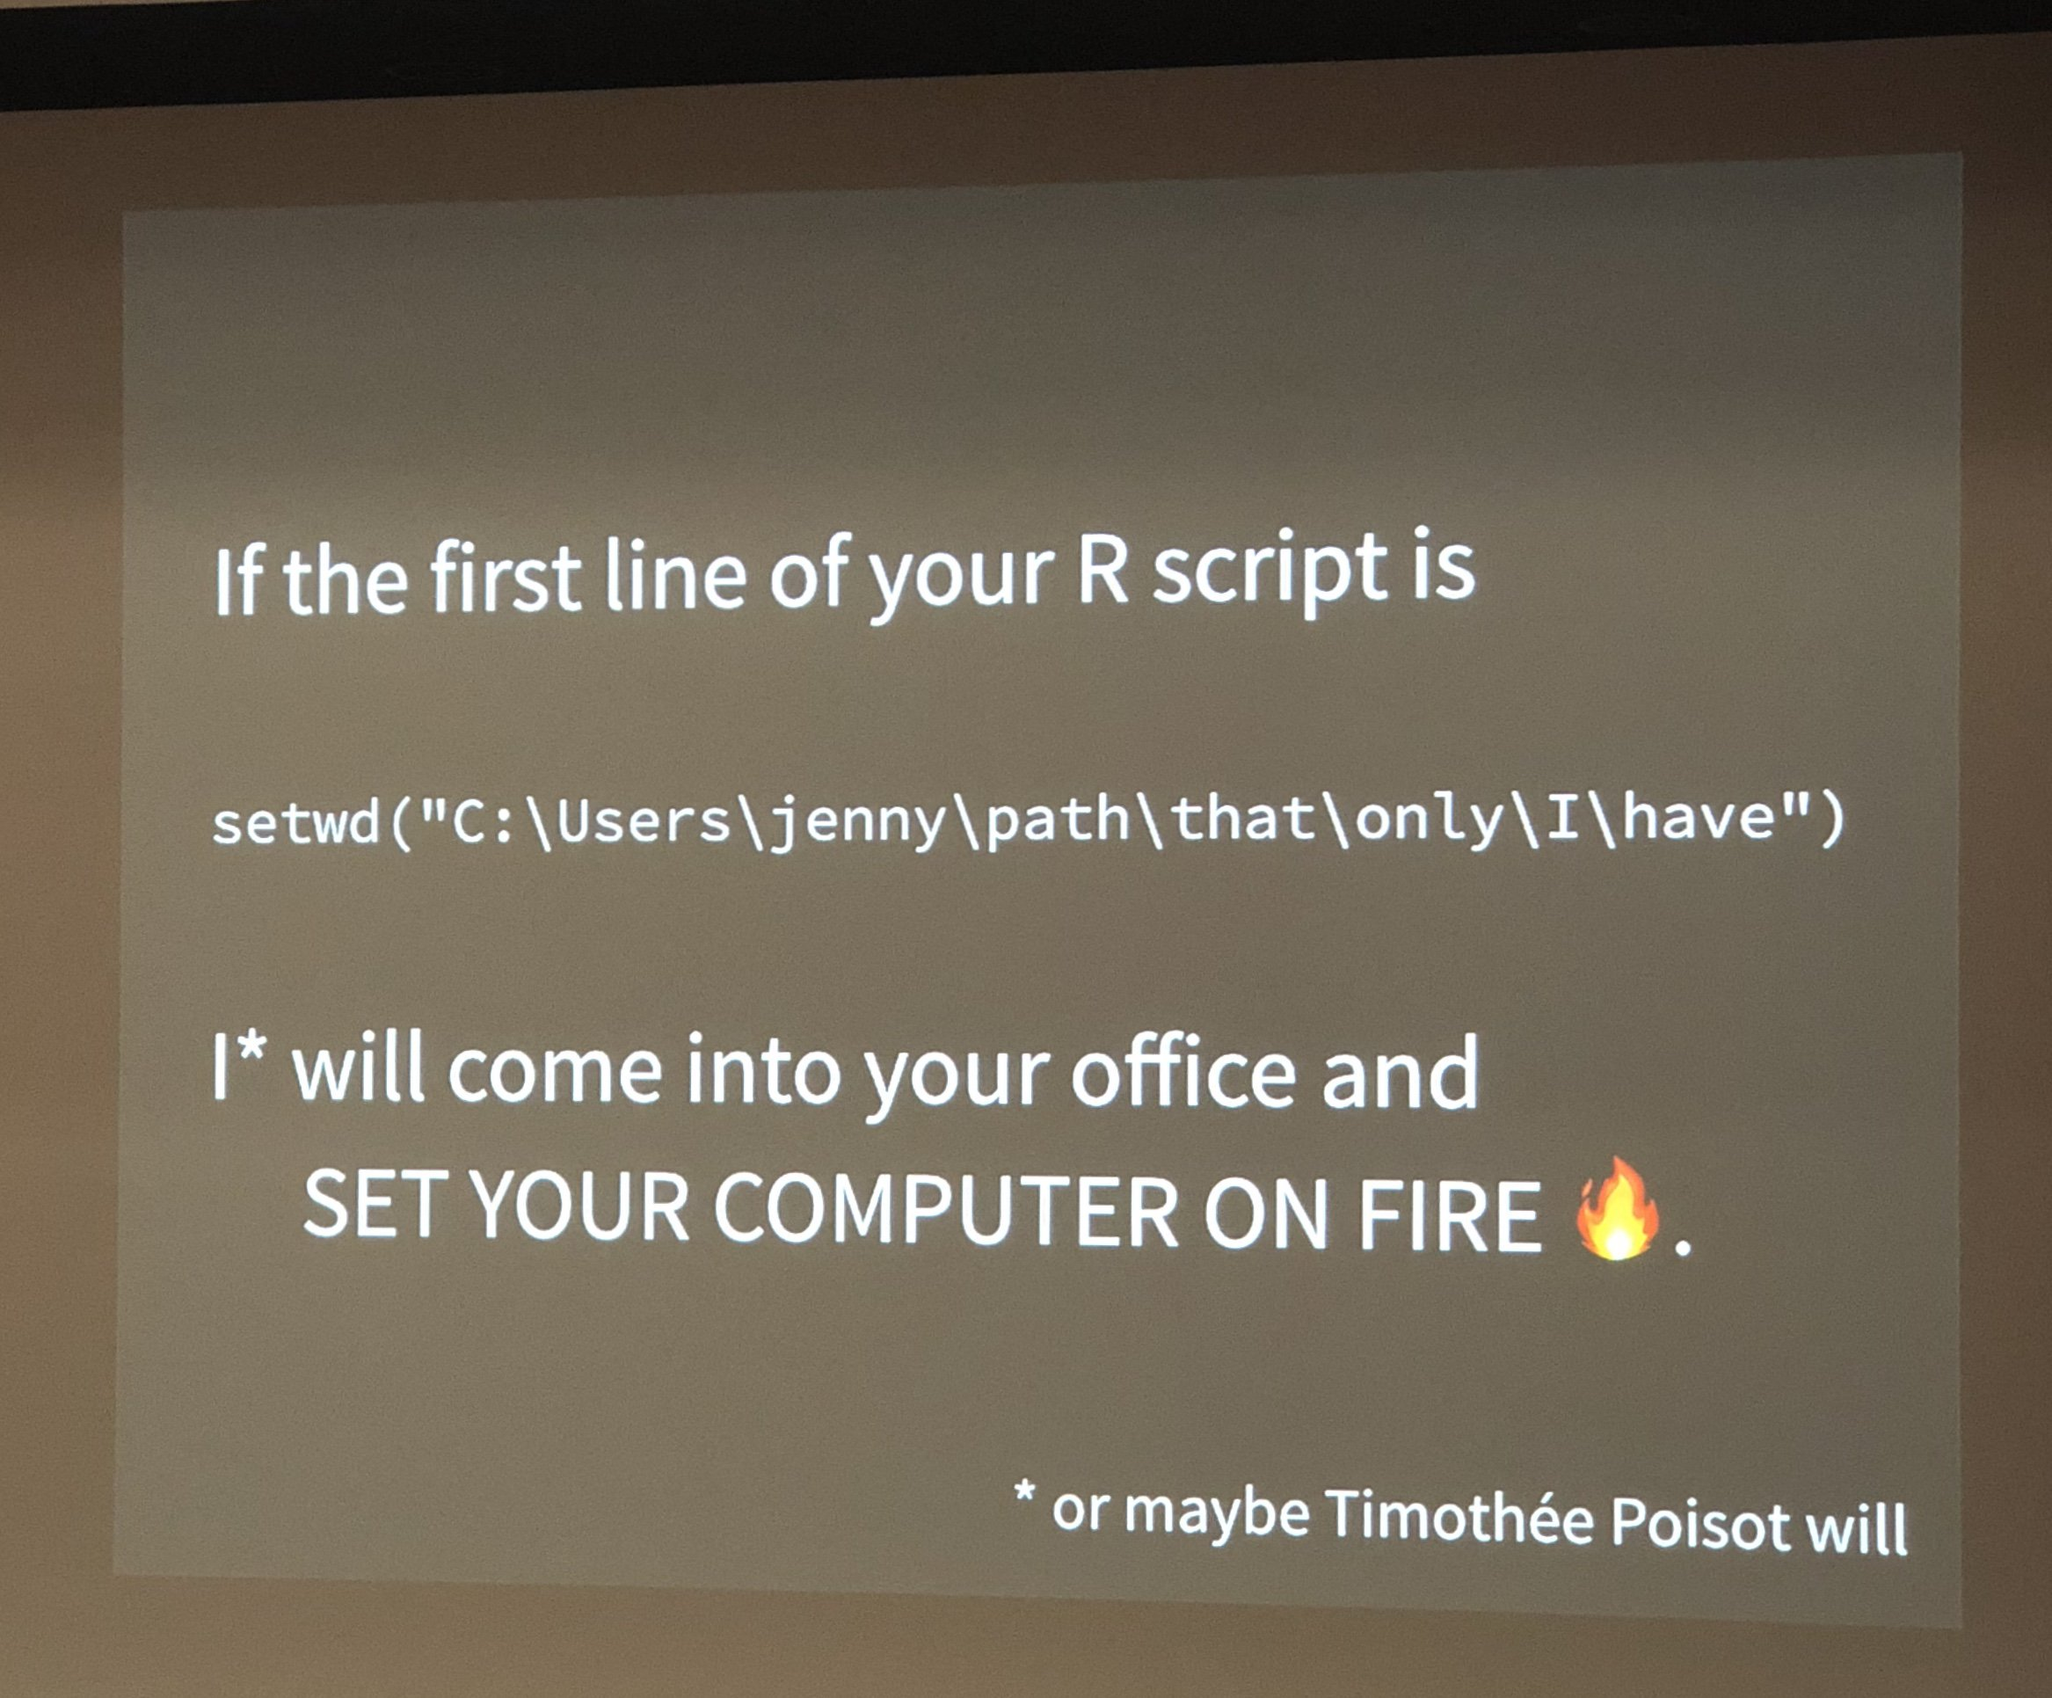
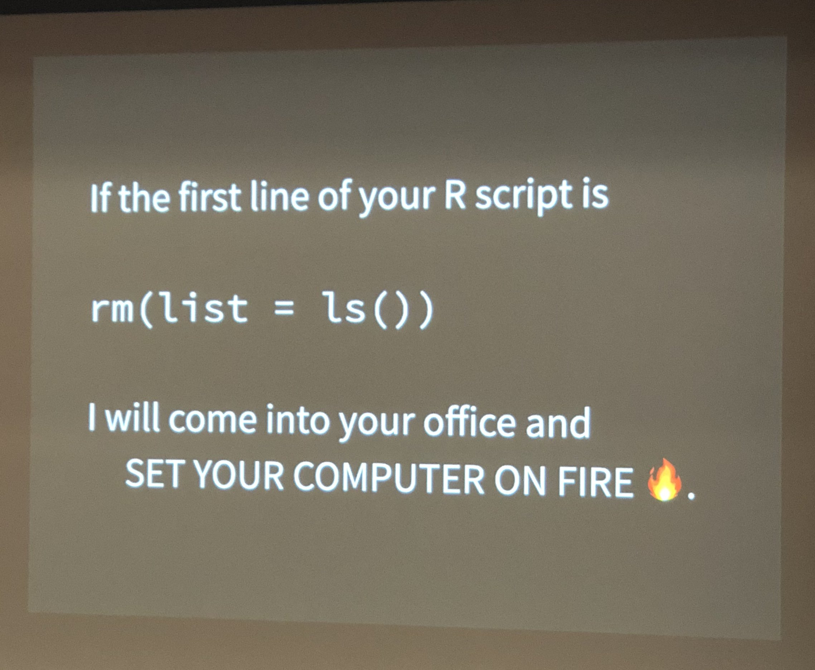
R Package Highlight: {here}
Notes:
And absolute paths aren’t much better if you collaborate/work on different systems, move folders around…..

Slide 26
DEMO

Slide 27
R Package Highlight: {here}
Project-based workflows
Self-contained and portable
Useful for collaboration & future you
Rmarkdown
Sets working directory to file location
Similar to file.path(), safe across operating systems

Slide 28
R Package Highlight: {here}
Is a file named .here present?
Is this an RStudio Project? Literally, can I find a file named something like foo.Rproj?
Is this an R package? Does it have a DESCRIPTION file?
Is this a remake project? Does it have a file named remake.yml?
Is this a projectile project? Does it have a file named .projectile?
Is this a checkout from a version control system? Does it have a directory named .git or .svn? Currently, only Git and Subversion are supported.

Slide 29
R Package Highlight: {here}
https://github.com/jennybc/here_here
https://www.tidyverse.org/articles/2017/12/workflow-vs-script/

Slide 30
Marta Jankowska
Assistant Professor at UC San Diego
Background: Geography, public health, epidemiology
User since: 2017
R expertise: telling my students what to do in R (lots of stats and spatial modeling), but my mission is to become more proficient myself!

Slide 31
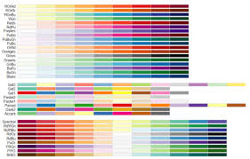
R package highlight: RColorBrewer
Make pretty maps and plots with scientifically researched color schemes
Supplement this info with colorbrewer2.org
Developed by Cinthia Brewer

Slide 32
Lets Talk!
Who are you?
What is your background?
What do you want to learn and what is your expertise level in R?
If you haven’t yet, please go to https://bit.ly/2m7GQwR and fill in the survey to tell us a bit about yourself
Future meeting formats

